Slide 1
Data Analysis: Covid Vs Monkeypox
Group 20:
Mohammad Shaik
Rajesh Tummala
Kranthi Mangalagiri
Niharika Thakur
Principles Of Big data Management

Slide 2
Agenda
A Comparative Analysis of Global pandemic COVID 19 and Monkeypox and its Initiatives and the Evolution of Global Transmission examining data to discover the association.
Monkeypox and Corona have a significant impact on global population. In this project, We are going to work with the COVID19 & Monkeypox dataset, published by kaggle, which consists of the data related to the cumulative number of confirmed & death cases, per day, in each Country. By using Big Data tools, we are going perform Ingestion, Processing, Analyzing and Visualizing the reports.

Slide 3
Goals
Learning Insights from reading COVID19 & Monkeypox data
Pivoting the data.
Preparing it for the analysis by dropping columns and aggregating rows.
Plotting correlation between attributes.
Deciding on and calculating a good measure for our analysis.
Merging two datasets for Visualizing our analysis results.
Design and creating ETL Pipeline.
Integrating Databricks notebook to ETL Pipeline to automate the Data Preprocessing.

Slide 4
Technology Stack
Python (PySpark Framework)
Data Wrangling
Data Cleaning & Preprocessing (Numpy, pandas)
Exploratory Data Analysis
Data Visualization (seaborn, matplotlib, plotly)
Notebook Creation (Databricks).
ETL Pipeline (Azure Data Factory).

Slide 5
Structural Outline
ETL PipeLine
Data Bricks
Source
Ingestion
Data Wrangling
EDA
Data Cleaning & Preprocessing

Slide 6
COVID-19 Outbreak Analysis

Slide 7
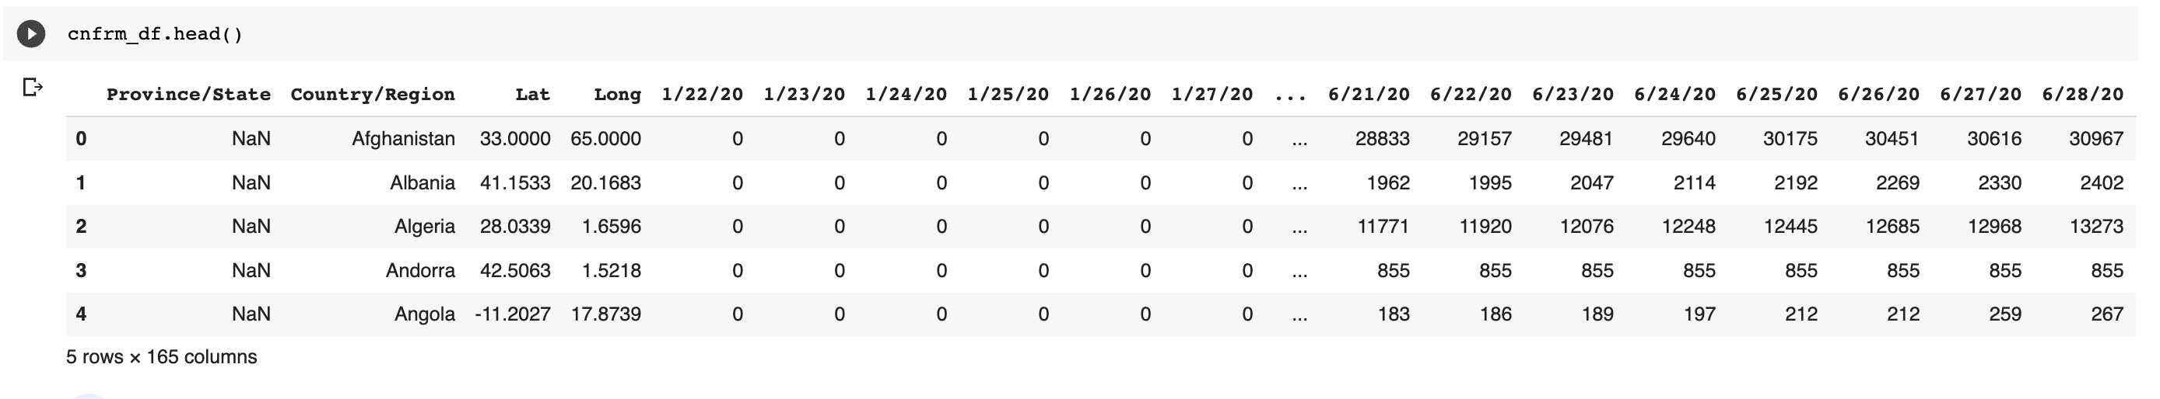
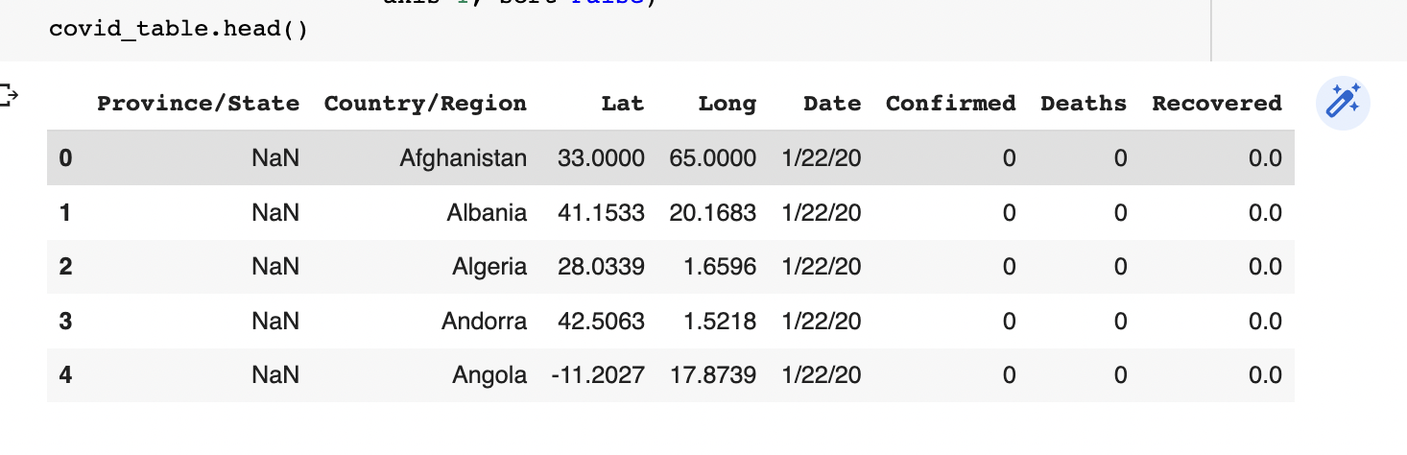
ETL(Data Extraction)
Data Ingestion of world-wide Confirmed, Death & Recovered cases datasets.
Data Wrangling had been done on the Confirmed cases dataset.

Slide 8
ETL(Data Transformation)
Data Cleaning and Preprocessing
Renaming column names.
Check null values in the dataset and fill those null or missing values as per analysis.
Modifying the datatypes of a dataset.
Removing Uncertainity or Inconsistance in data

Slide 9
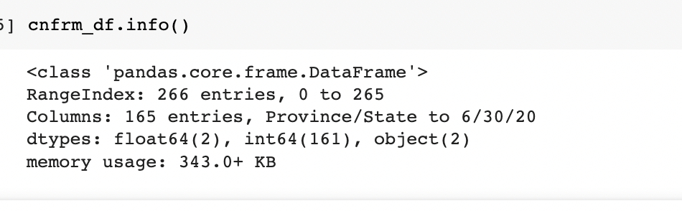
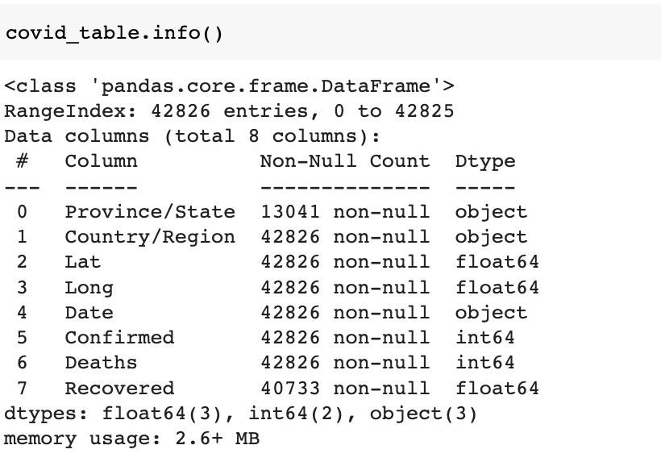
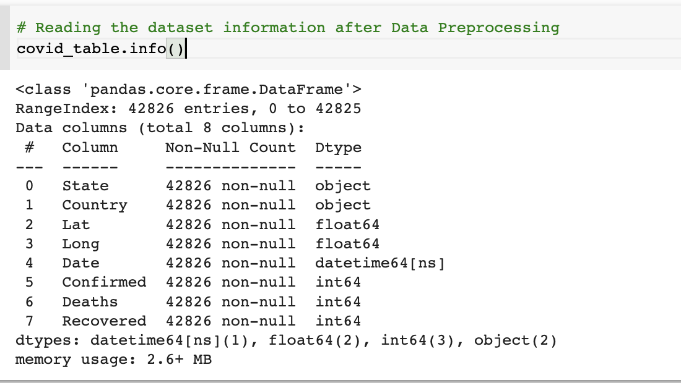
ETL(Data Transformation)
Dataset Information before and after Data Wrangling, Cleaning and Preprocessing

Slide 10
ETL(Data Load)
After data transformation, the processed data has been loaded as CSV for further cooperative analysis.
Write the processed path as CSV mentioned in below path.

Slide 11
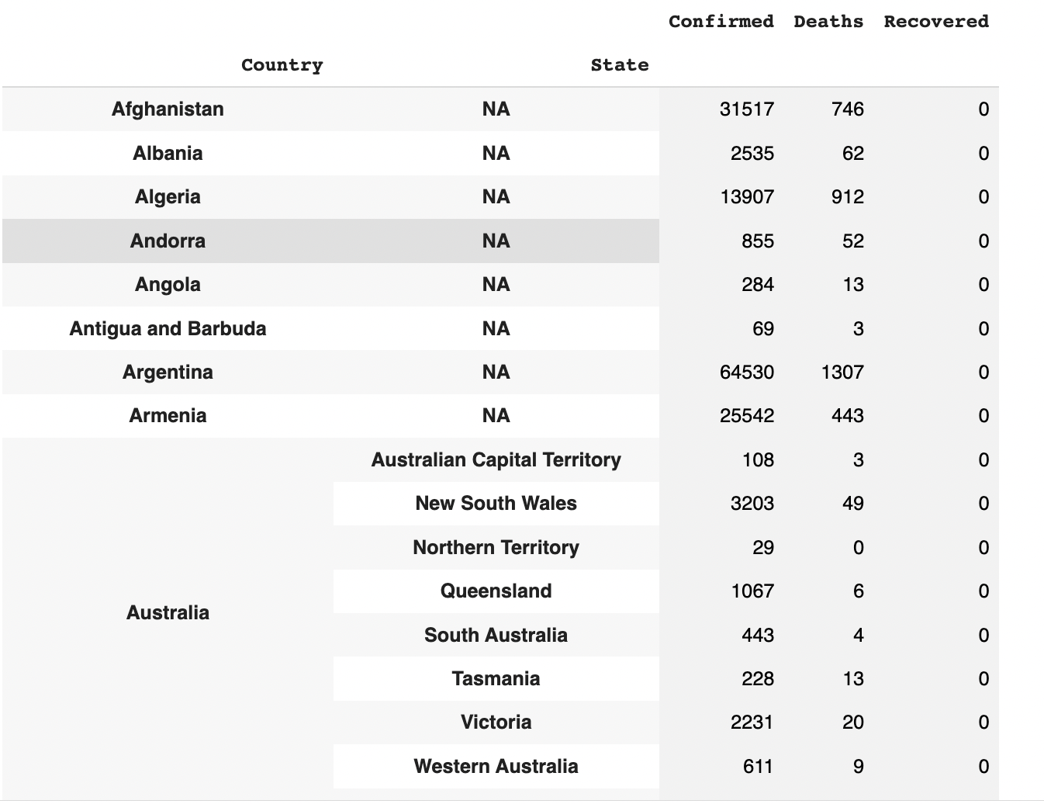
Exploratory Data Analysis
Merged the datasets of confirmed, Deaths & Recovered into one final data frame as below which shows the cases for each country with respective to state.

Slide 12
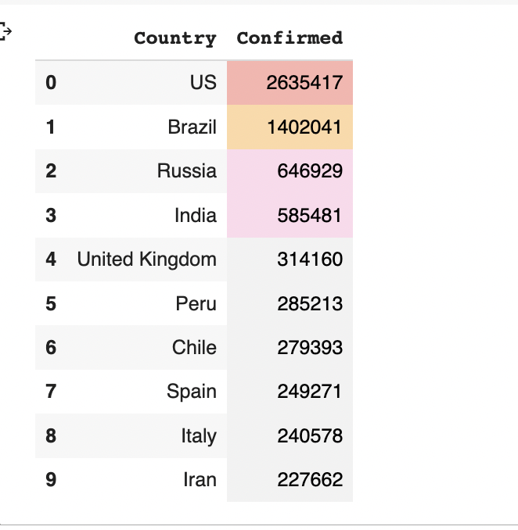
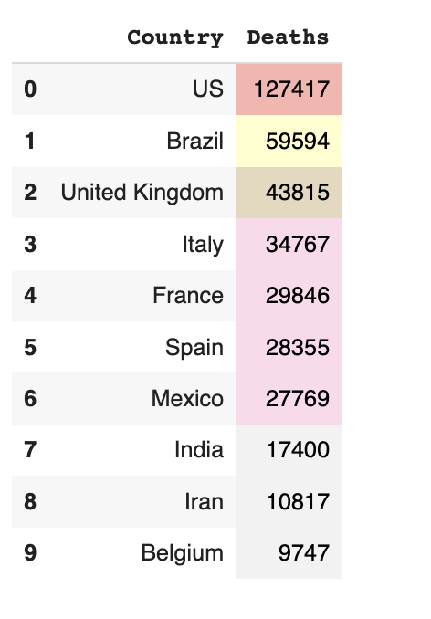
Exploratory Data Analysis
Top 10 Countries with most no. of Confirmed cases and Death cases.

Slide 13
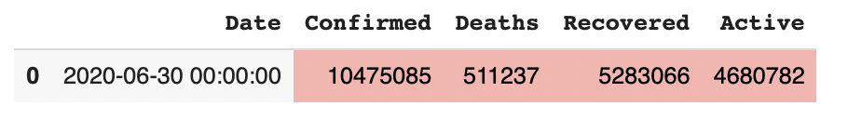
Exploratory Data Analysis
Similarly, Data Ingestion, Data Cleaning & Preprocessing, EDA for covid_19_clean_complete has been done.
Analysis showing that total number of Confirmed, Deaths & Recovered Cases as per the latest date.

Slide 14
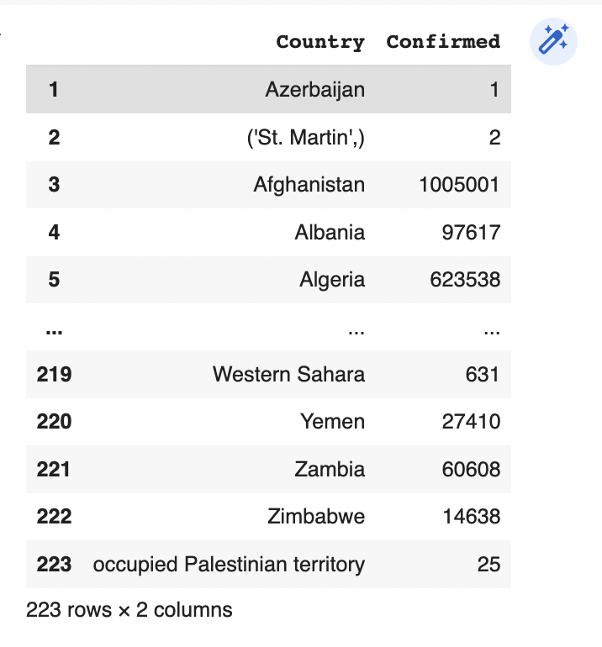
Exploratory Data Analysis
Number of Confirmed Cases for each country as per latest date.

Slide 15
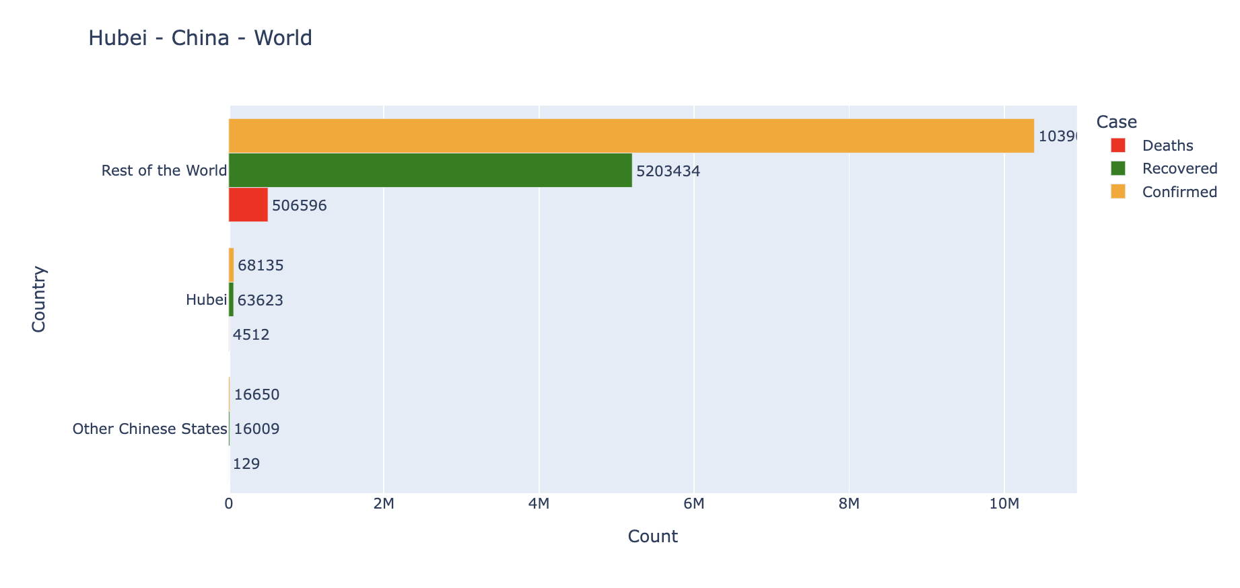
Data Visualization
As the first case was found in Hubei, Wuhan. Here we were comparing the cases with respect to Wuhan state, other Chinese states as well as rest of the world for the latest date

Slide 16
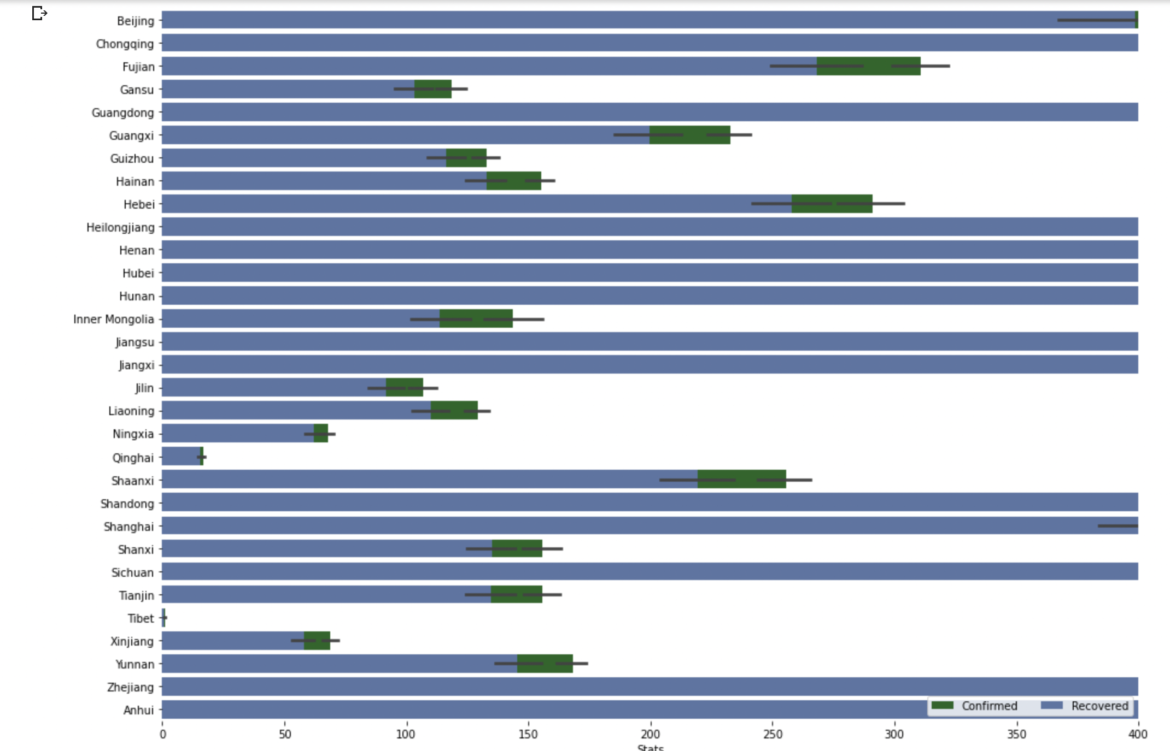
Data Visualization
Plot representation for Confirmed vs Recovered of Sates of China other than Hubei Number of Confirmed Cases for each country as per latest date.

Slide 17
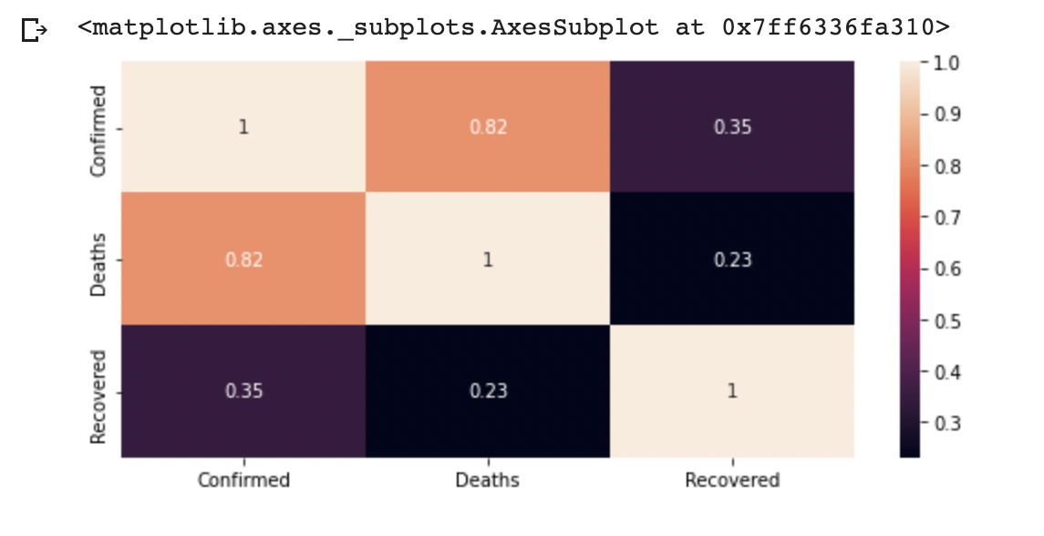
Data Visualization
Correlation heat map between Confirmed, Death and Recovered Cases
From Correlation heat map, Deaths are linearly correlated to the Confirmed Cases. As there is no vaccination or no proper treatment or no awareness resulted in high mortality rates in the initial stages.

Slide 18
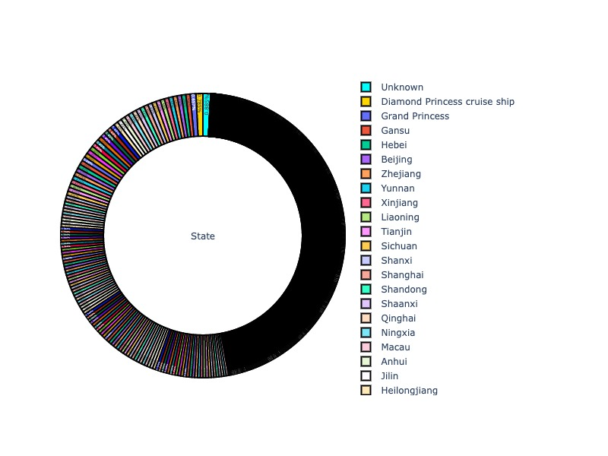
Data Visualization (Pie Plots)
Percentage of confirmed covid cases for each State

Slide 19
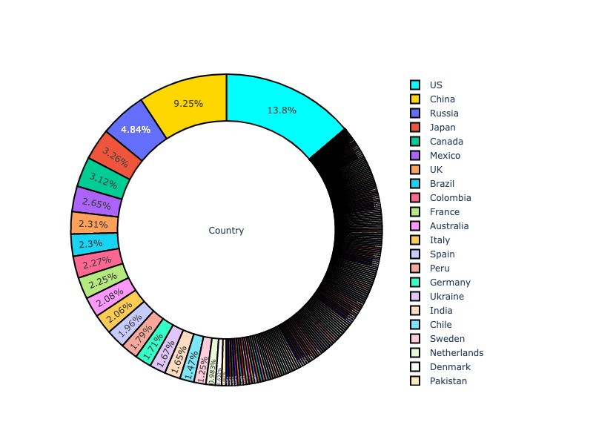
Data Visualization (Pie Plots)
Percentage of confirmed covid cases for each Country

Slide 20
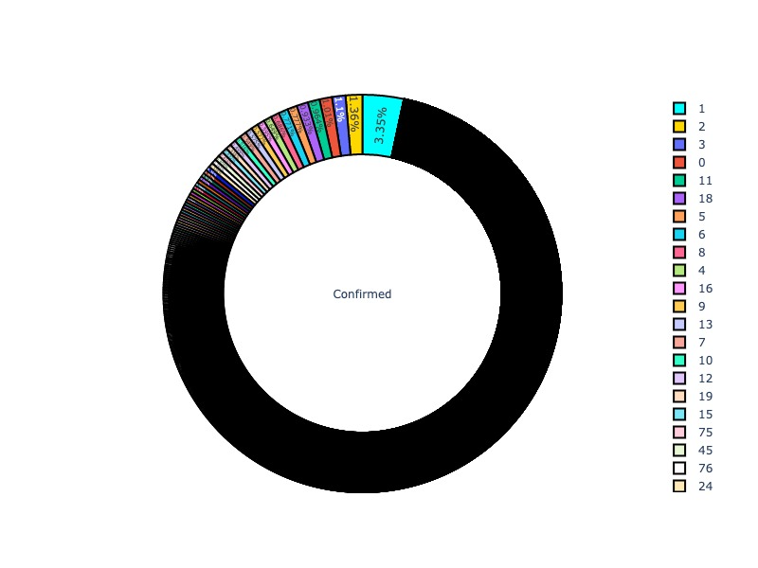
Data Visualization (Pie Plots)
Percentage of dates reporting individual count of Confirmed Cases

Slide 21
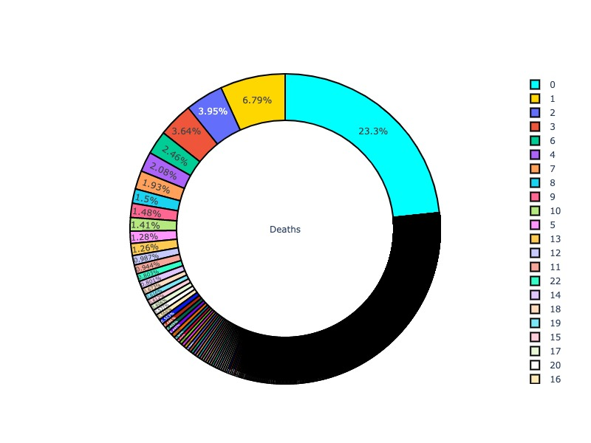
Data Visualization (Pie Plots)
Percentage of dates reporting individual count of Deaths Cases

Slide 22
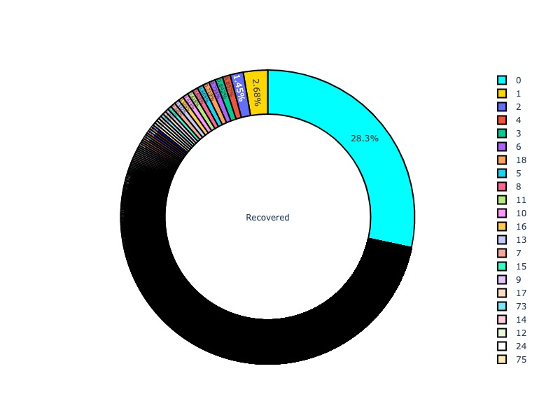
Data Visualization (Pie Plots)
Percentage of dates reporting individual count of Recovered Cases

Slide 23
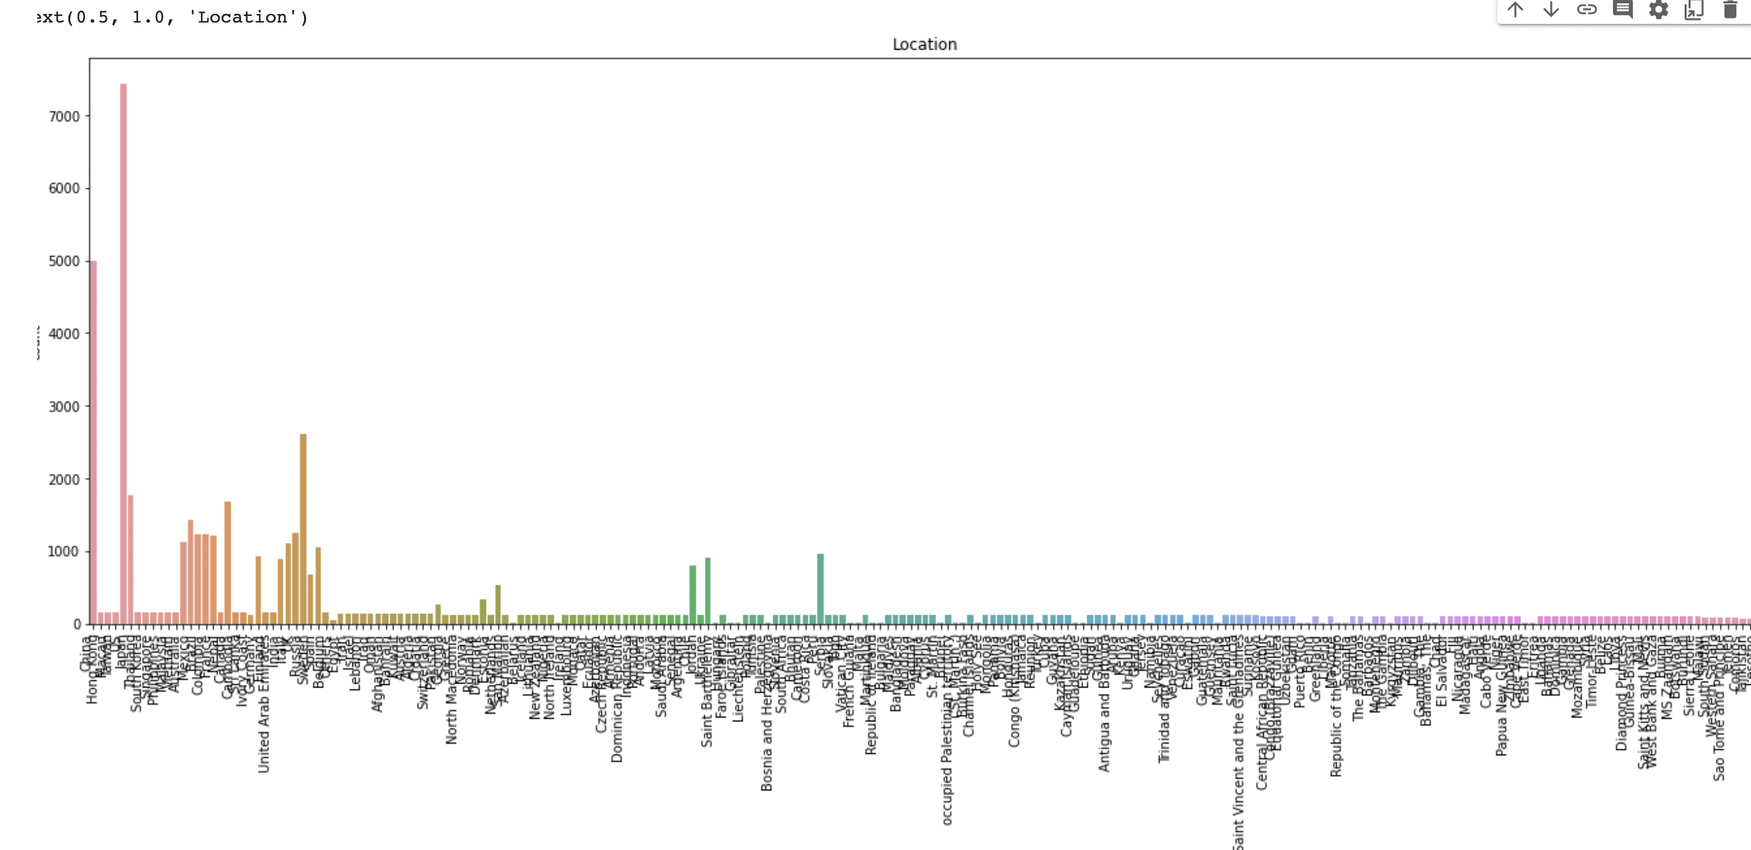
Data Visualization
Bar plot representation of the Confirmed Cases Count for each country.

Slide 24
Monkey Pox Outbreak Analysis

Slide 25
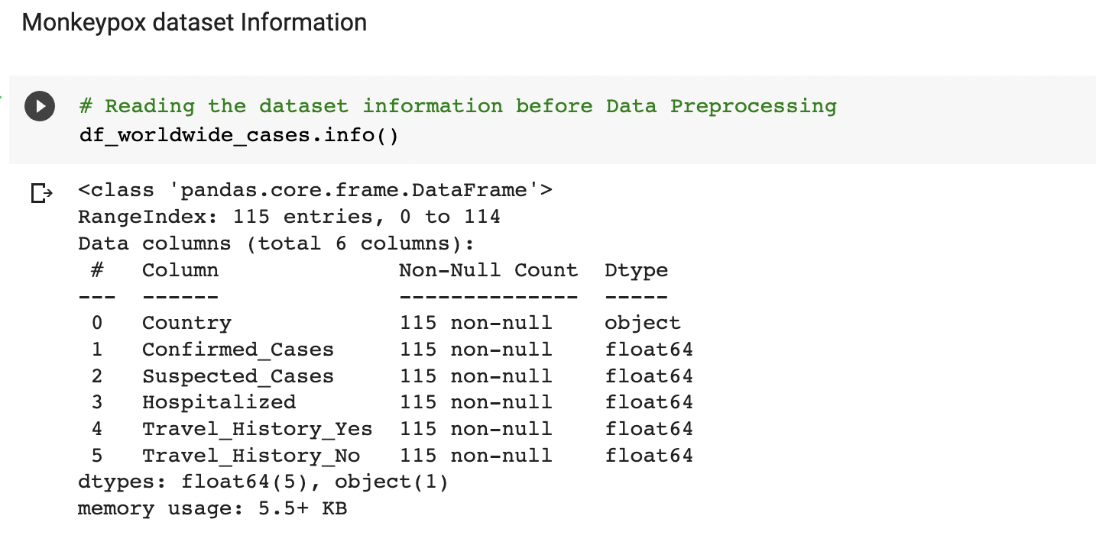
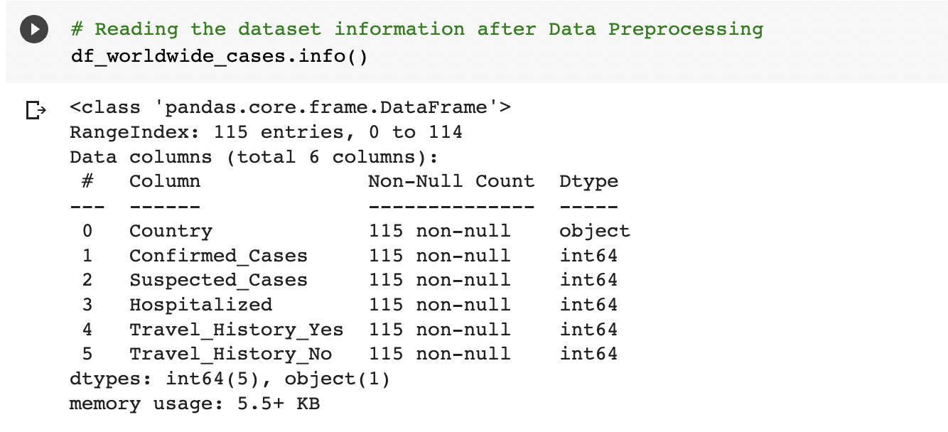
ETL
Similarly to Covid Analysis, Data Ingestion, Data Wrangling, Data Cleaning & Data Preprocessing and Data Loading has been done.
Processed data has been written as CSV for further Comparative Analysis.

Slide 26
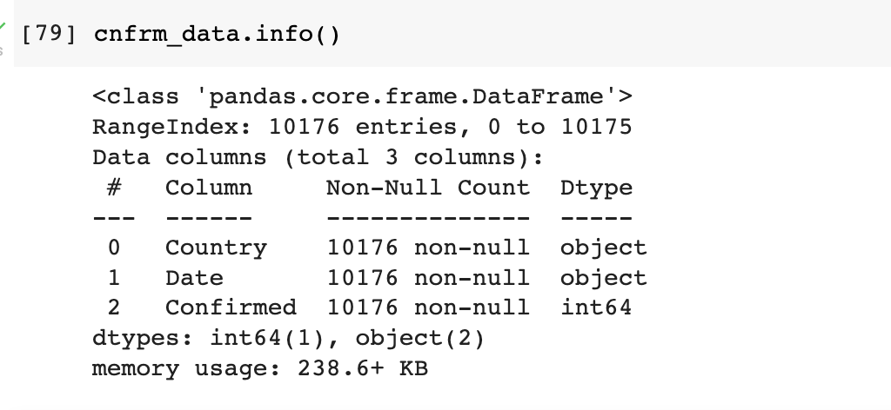
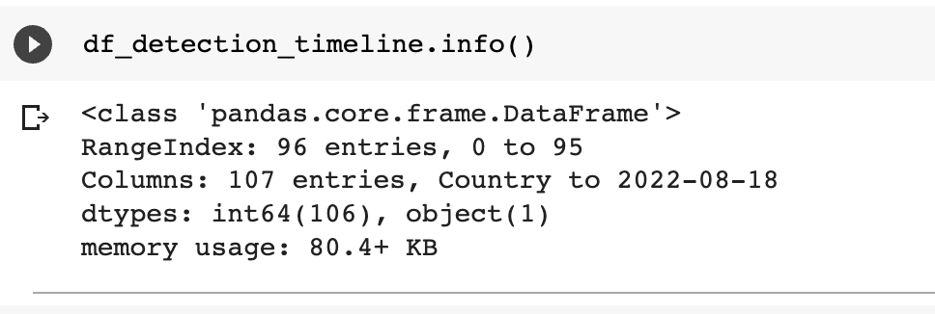
ETL

Slide 27
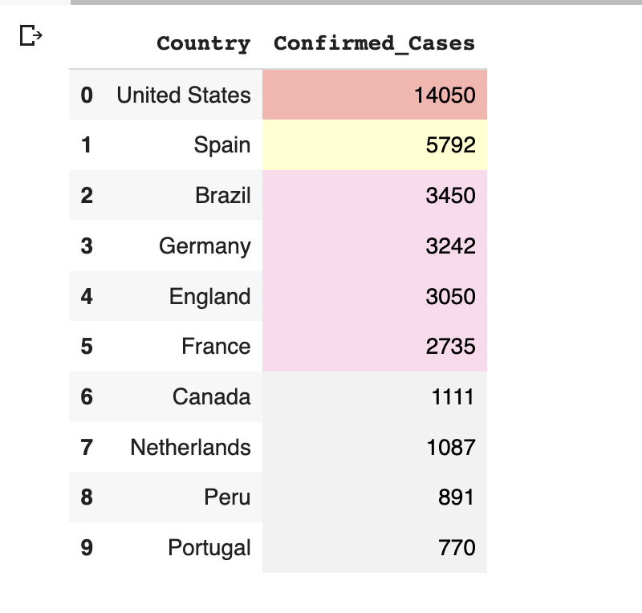
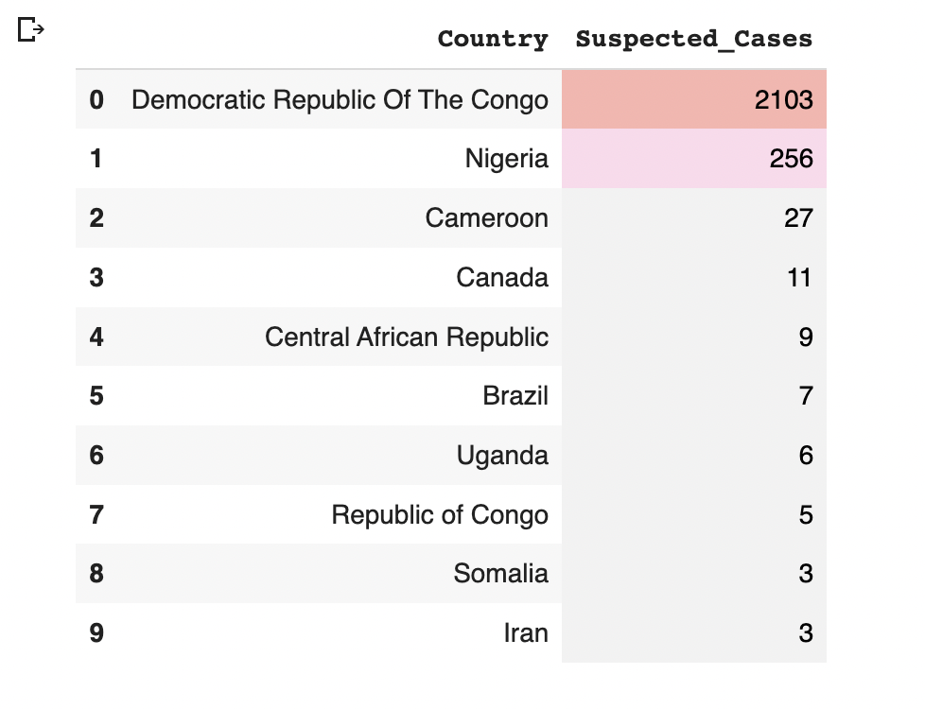
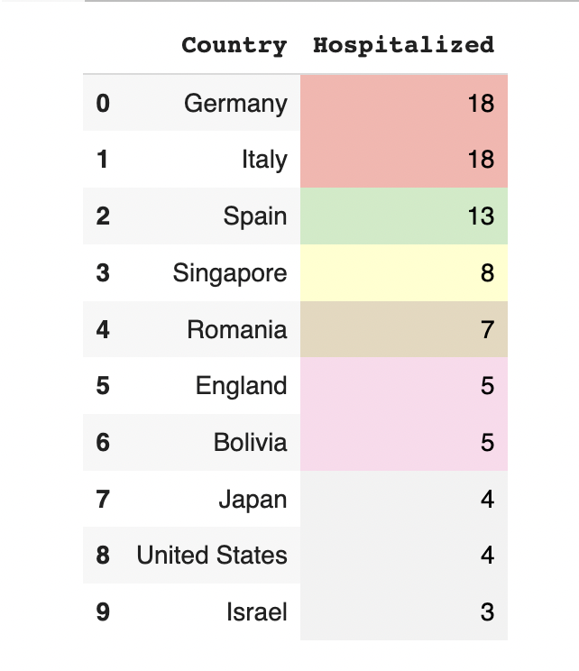
Exploratory Data Analysis
The top 10 countries with most no of Confirmed, Suspected and Hospitalized cases

Slide 28
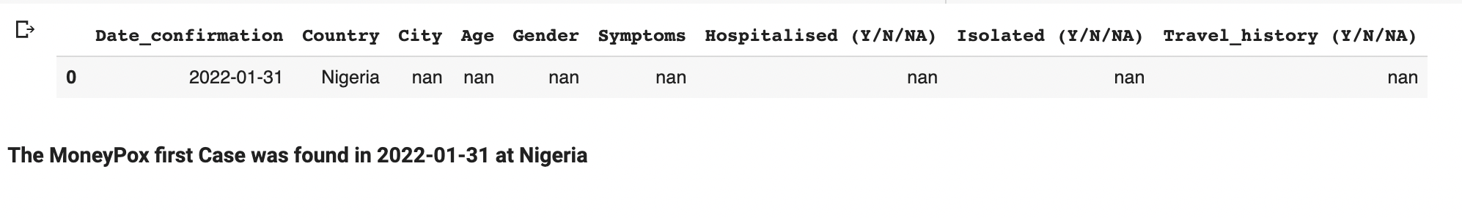
Exploratory Data Analysis
Monkeypox First Case

Slide 29
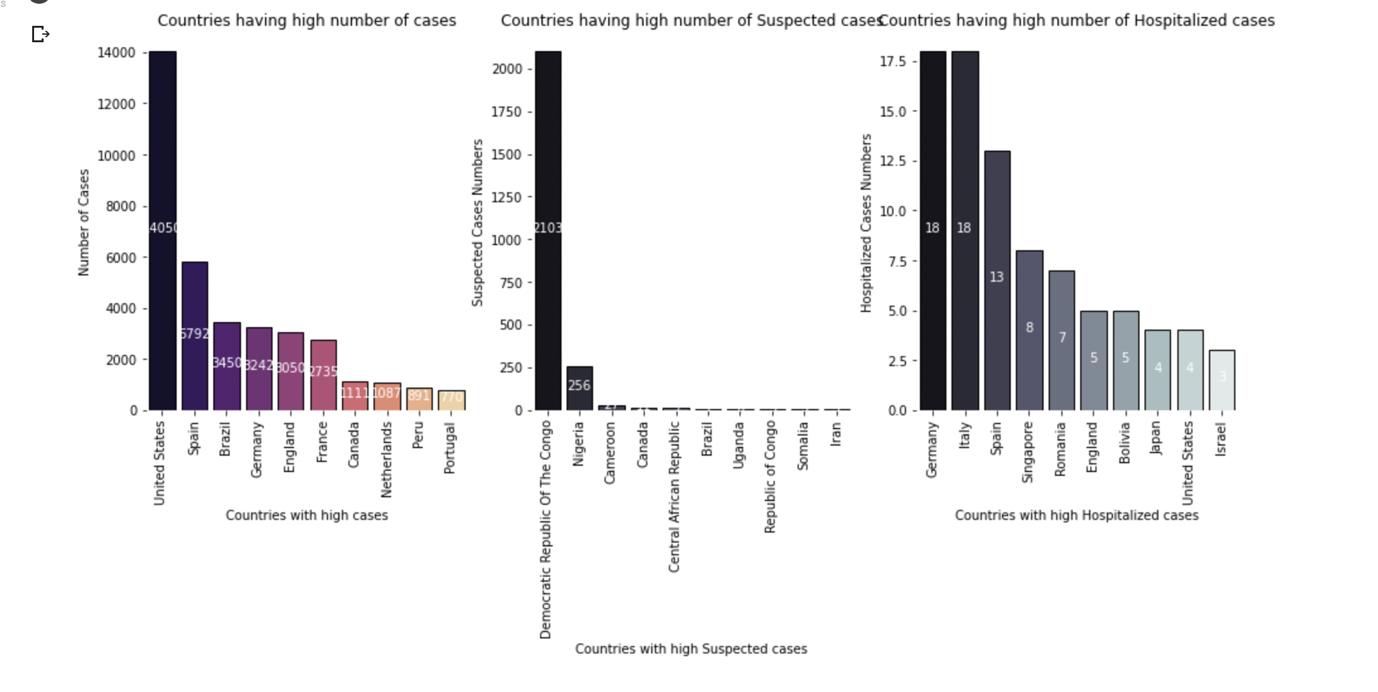
Data Visualization
Top 10 countries with highest number of cases Worldwide

Slide 30
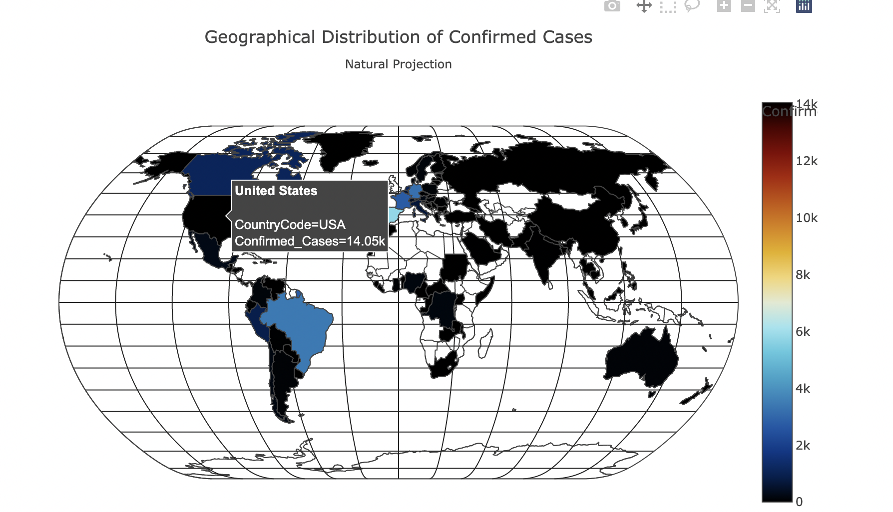
Data Visualization
Geographical Distribution of Confirmed Cases Natural Projection

Slide 31
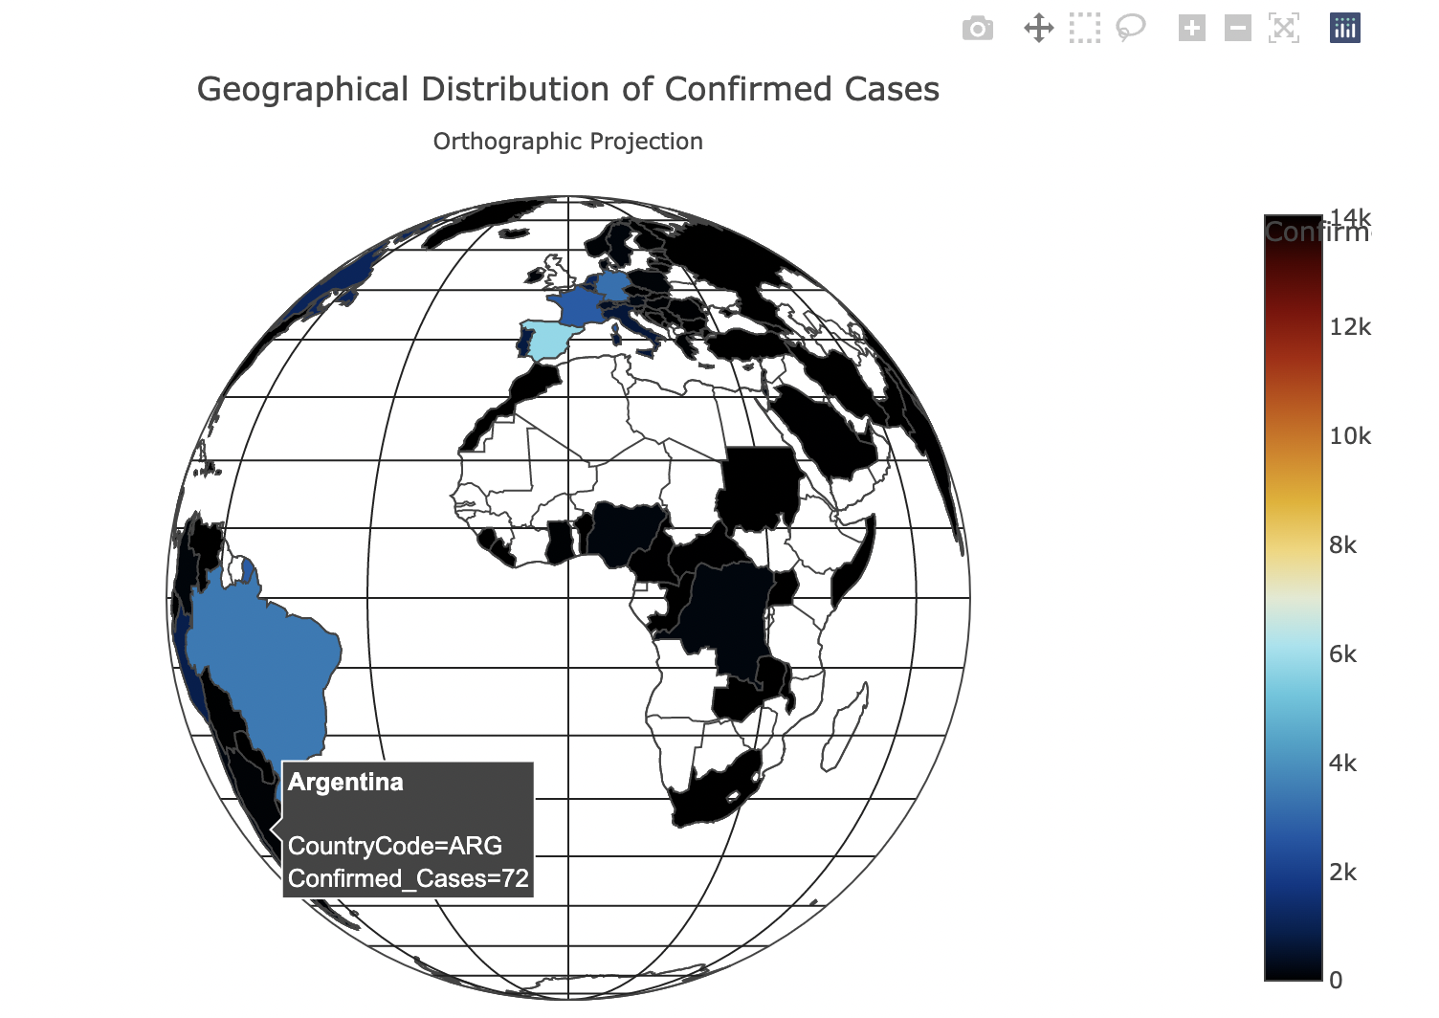
Data Visualization
Geographical Distribution of Confirmed Cases Orthographic Projection

Slide 32
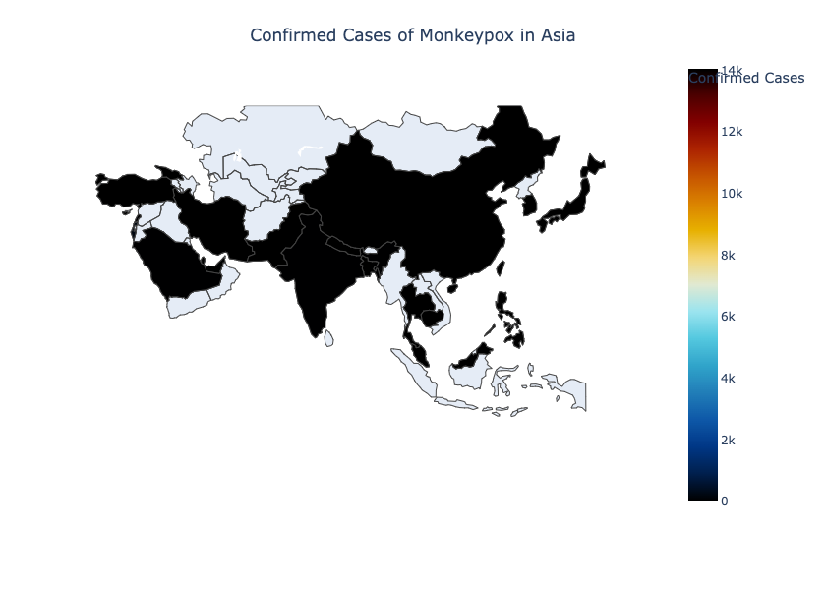
Data Visualization
Geographical Distribution of Confirmed Cases for Asia

Slide 33
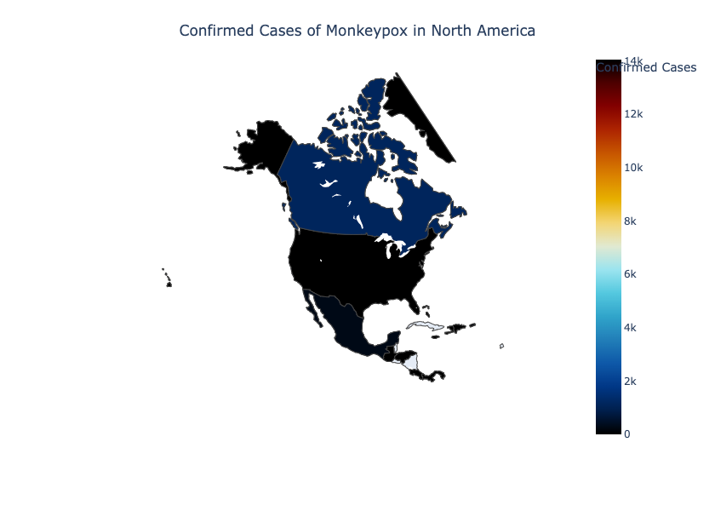
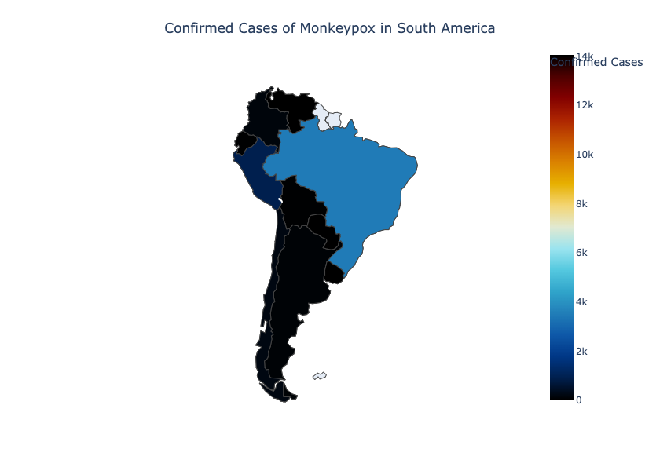
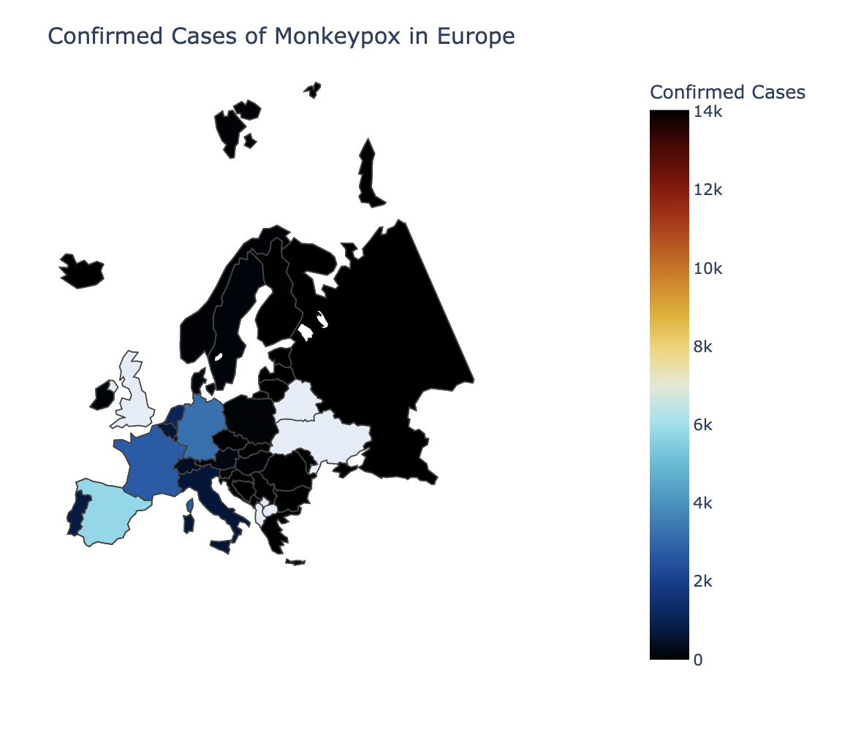
Data Visualization
Map representation of Monkeypox Confirmed Cases for top 3 Continents

Slide 34
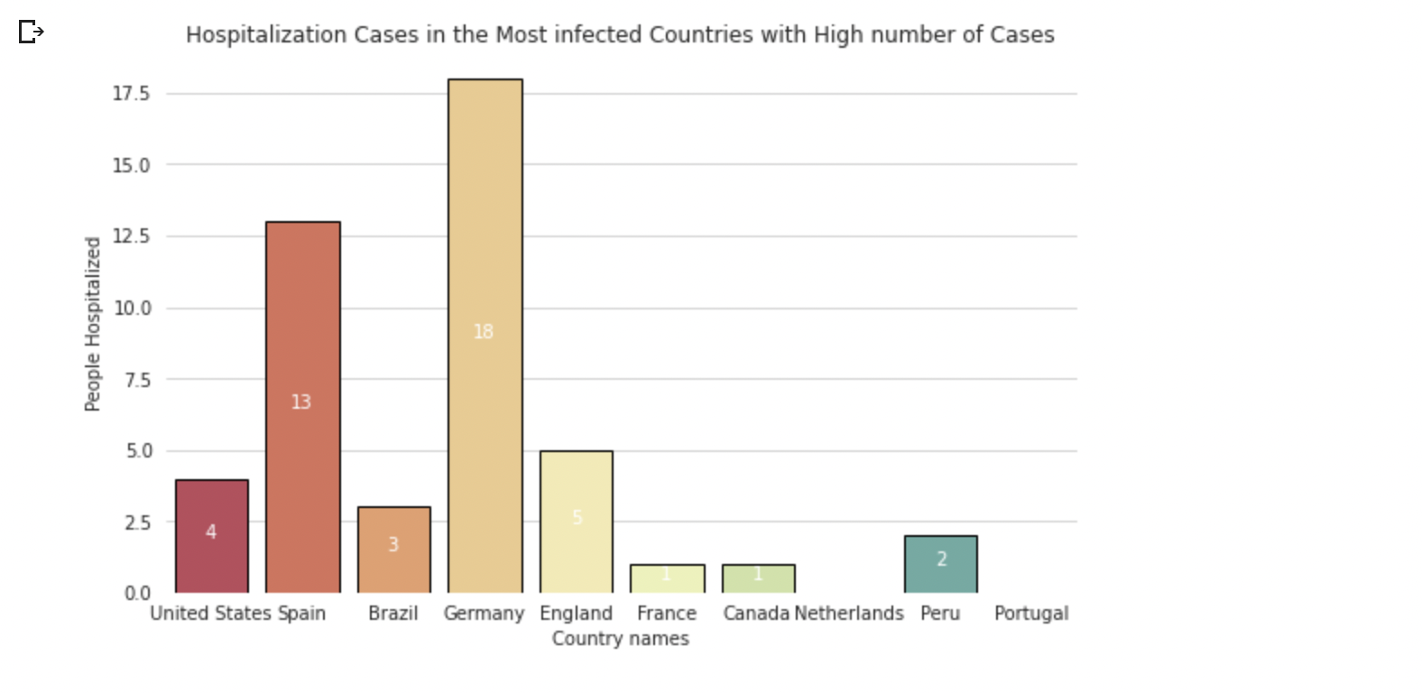
Data Visualization
Bar plot representation of Hospitalized Cases with for top 10 most infected countries

Slide 35
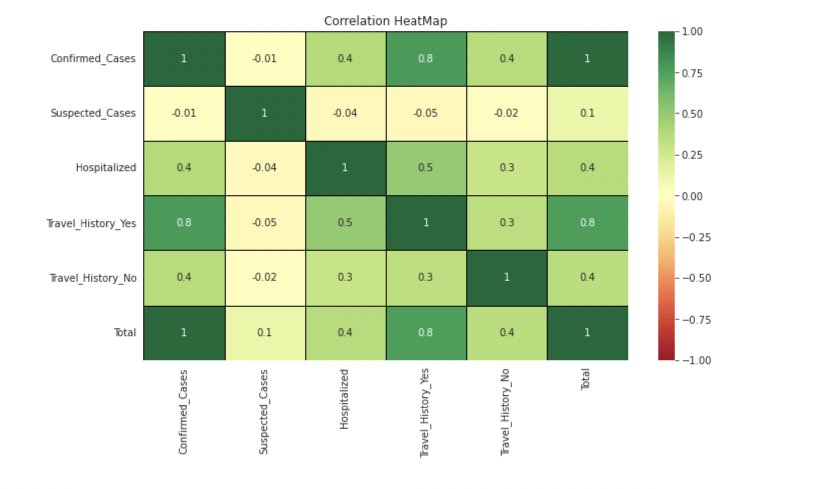
Data Visualization
Correlation Heat Map
From Correlation heat map, Travel history is highly correlated to Confirmed Cases i.e., Confirmed Cases are highly dependent upon Traveling history where traveling has a high impact on spreading of virus..

Slide 36
Covid V/S Monkey Pox Outbreak Analysis

Slide 37
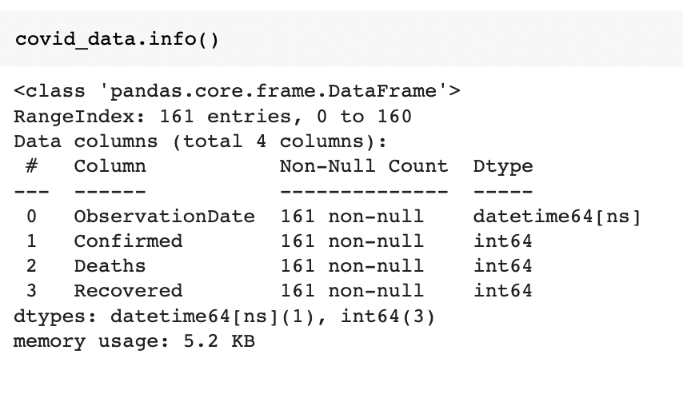
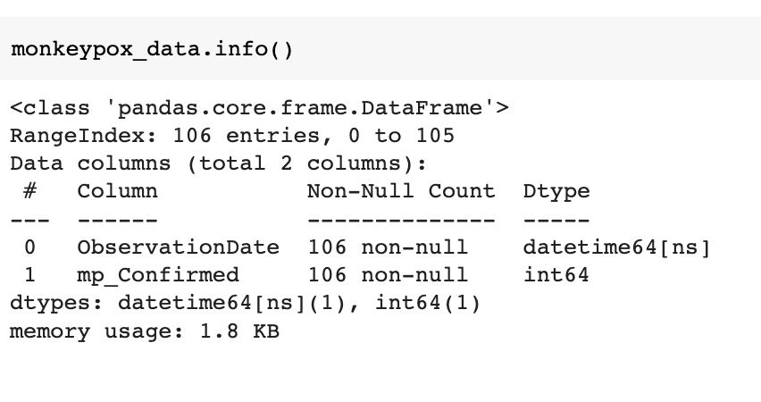
Covid & Monkeypox Data
Covid & Monkeypox processed data information

Slide 38
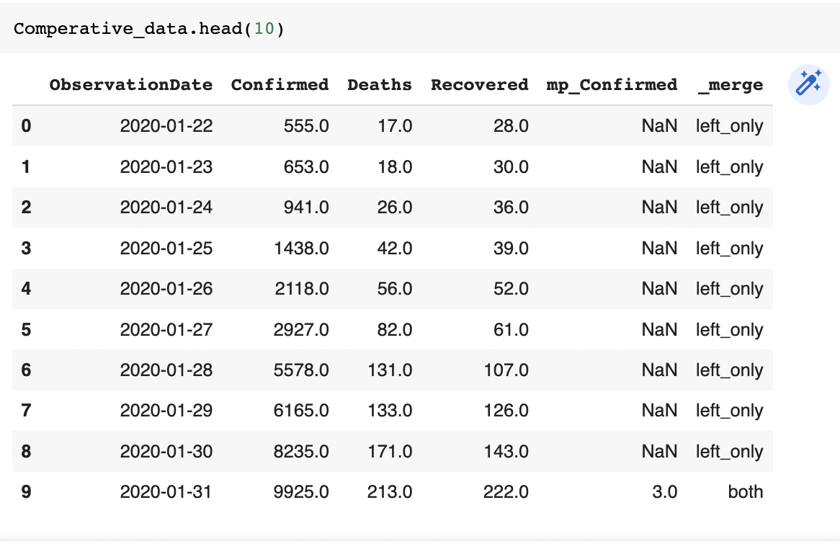
Covid & Monkeypox Data
Merged data frame of Covid & Monkeypox processed data

Slide 39
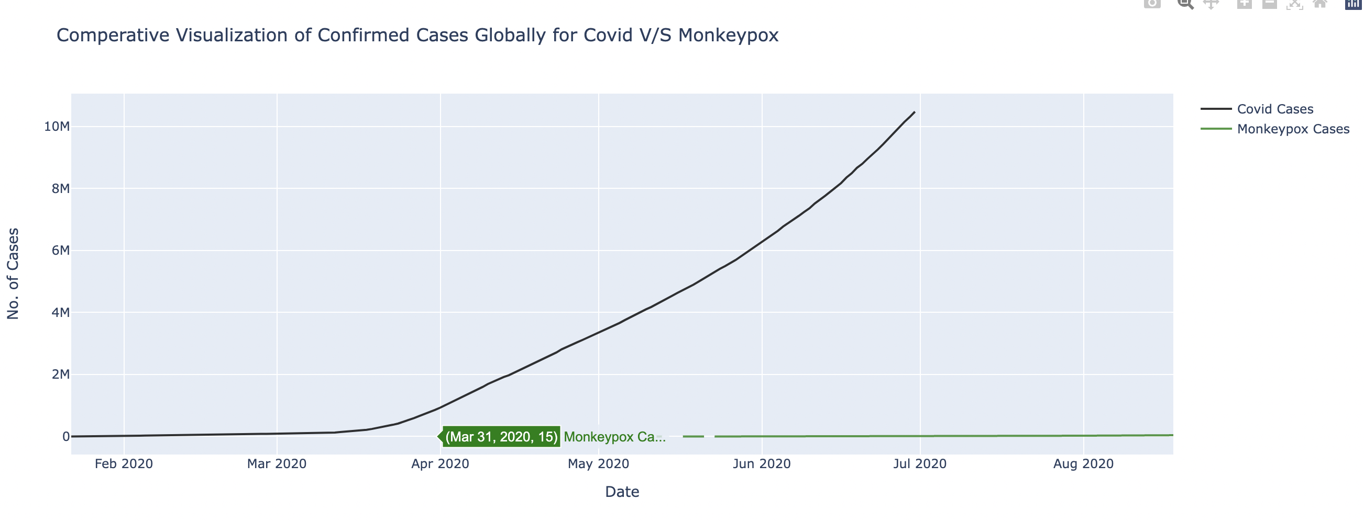
Data Visualization
Cumulative Number of Confirmed Cases for Covid V/S Monkeypox

Slide 40
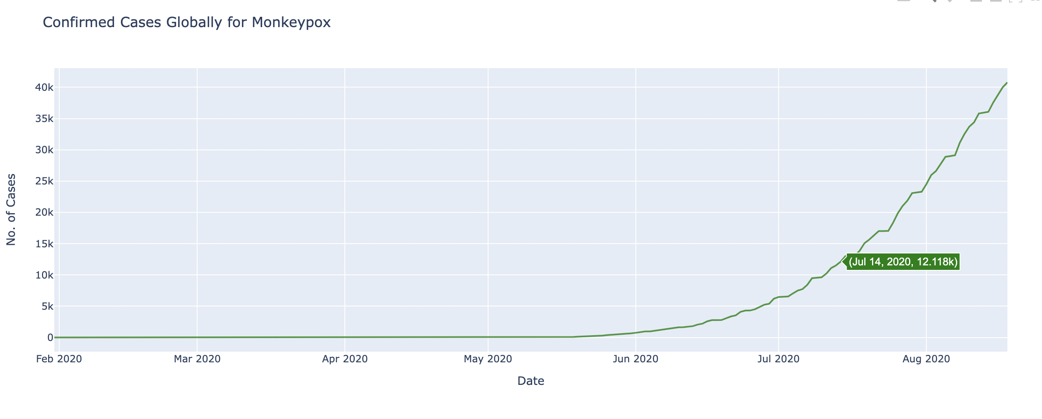
Data Visualization
Cumulative Number of Confirmed Cases over time for Monkeypox

Slide 41
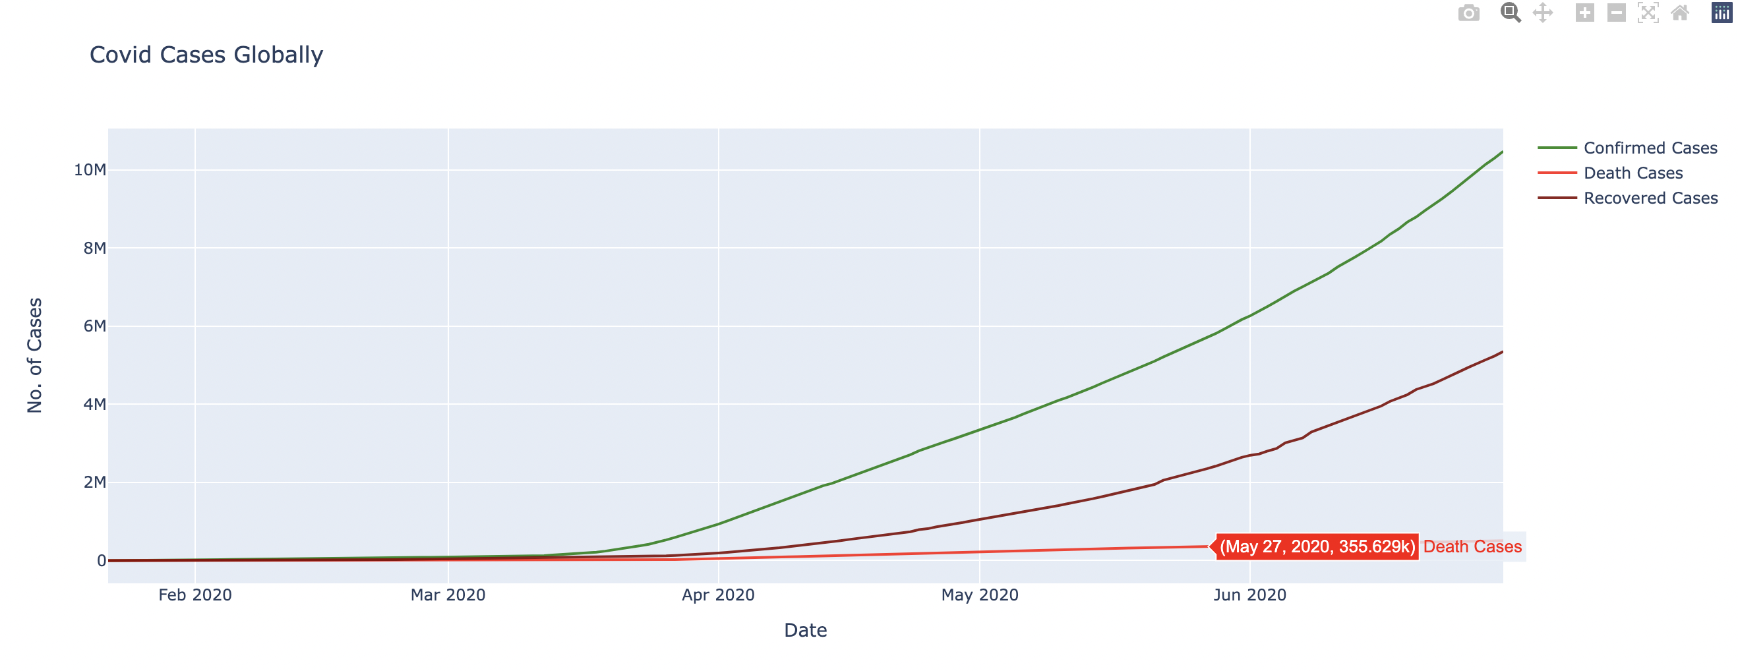
Data Visualization
Cumulative Number of Cases over time for Coronavirus

Slide 42
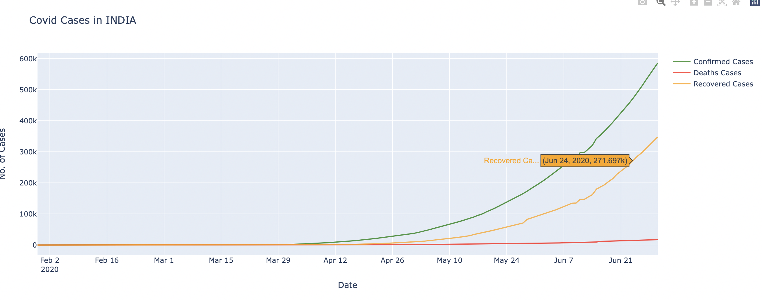
Data Visualization
Spread of the Coronavirus Over Time In India

Slide 43
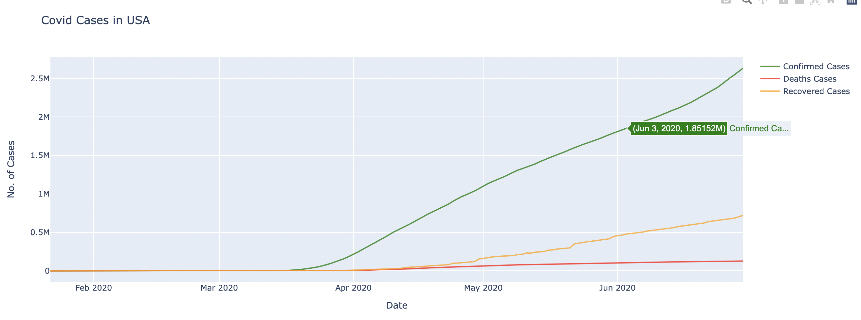
Data Visualization
Spread of the Coronavirus Over Time In USA

Slide 44
Future Scope
Conduct an additional Covid-19 analysis on the airline delays.
Undertake analysis on additional pandemics.
Conduct an analysis to determine impact of online business over Covid-19 or Money Pox.
Build Machine learning models.

Slide 45
Datasets
https://www.kaggle.com/datasets/imdevskp/corona-virus-report
https://www.kaggle.com/datasets/sudalairajkumar/novel-corona-virus-2019-dataset
https://www.kaggle.com/datasets/deepcontractor/monkeypox-dataset-dail updated?select=Daily_Country_Wise_Confirmed_Cases.csv
https://www.kaggle.com/code/andrewmvd/monkeypox-cases-analysis/data

Slide 46

Thank You!

